Slide 1
ML
Journey into the world of ?

Slide 2
Machine Learning
Machine learning is a field of computer science that uses statistical techniques to give computer systems the ability to "learn" with data, without being explicitly programmed.

Slide 3
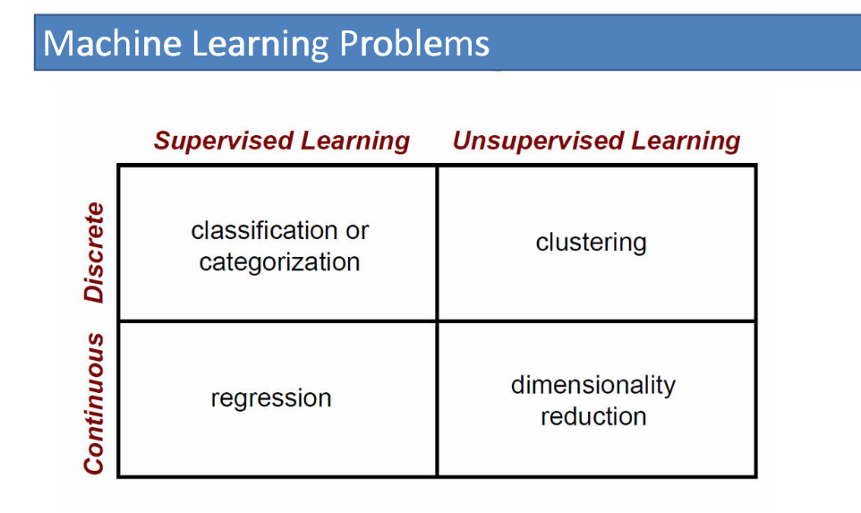

Slide 4
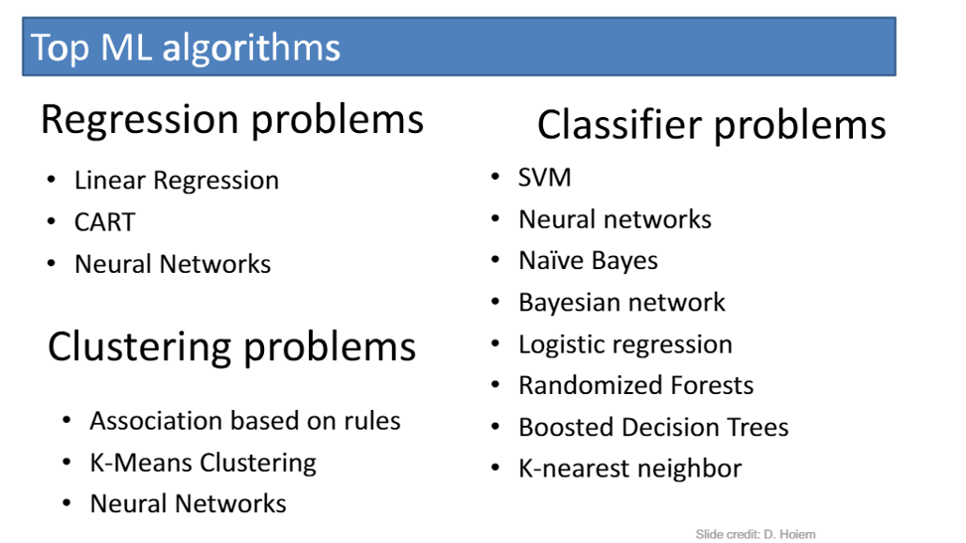

Slide 5
Regression Algorithms
Linear Regression
Polynomial Regression
Decision Trees
Random Forest Regression
SVM – SVR

Slide 6
Linear Regression
y = b + b₁X
YearsExperience | Salary
1.1 | 39343
1.3 | 46205
1.5 | 37731
2 | 43525
2.2 | 39891
2.9 | 56642
3 | 60150
3.2 | 54445
3.2 | 64445
3.7 | 57189
3.9 | 63218
4 | 55794
4 | 56957
4.1 | 57081
4.5 | 61111
4.9 | 67938
5.1 | 66029

Slide 7
Polynomial Regression
Example:
Plant Growth
Variables:
  Sunlight
  Water Supply
  Soil Type

Slide 8
Classification Algorithms
KNearestNeighbors Classifier
Logistic Regression
Decision Tree and Random Forest

Slide 9
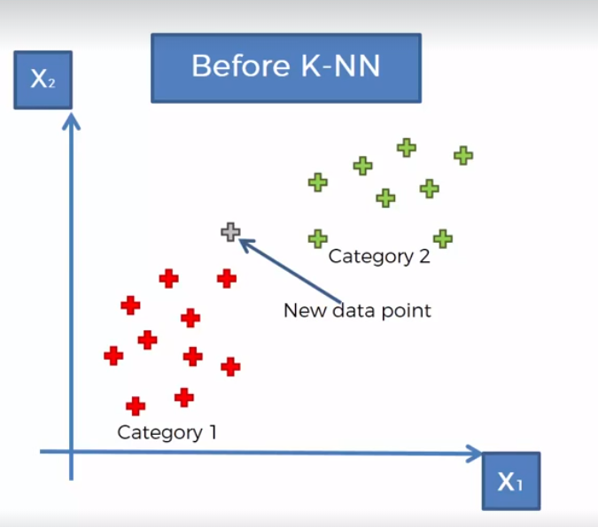
KNearestNeighbors Classification

Slide 10
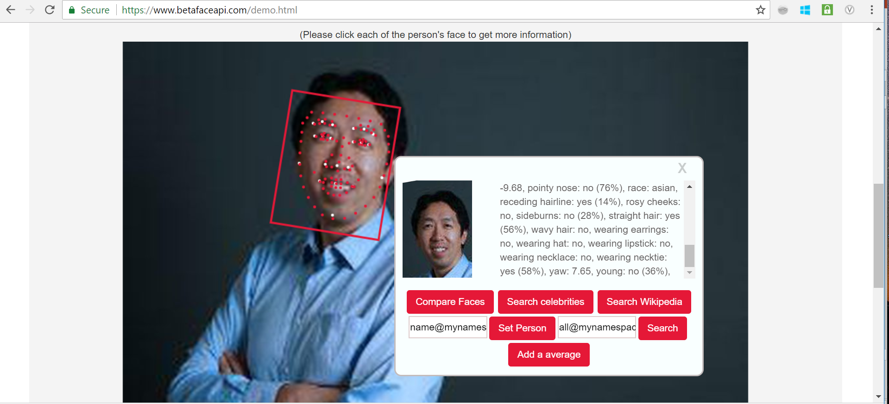

Slide 11
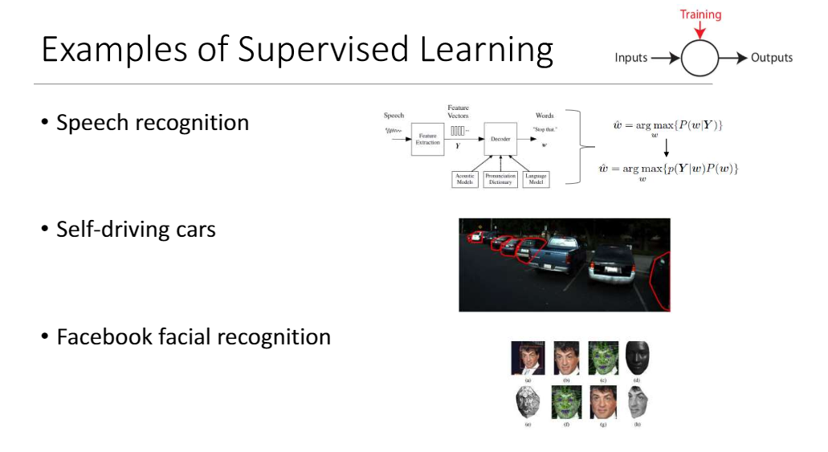

Slide 12
Clustering Algorithms
K Means
Hierarchical Clustering
  Agglomerative – Bottom up
  Divisive – Top Down

Slide 13
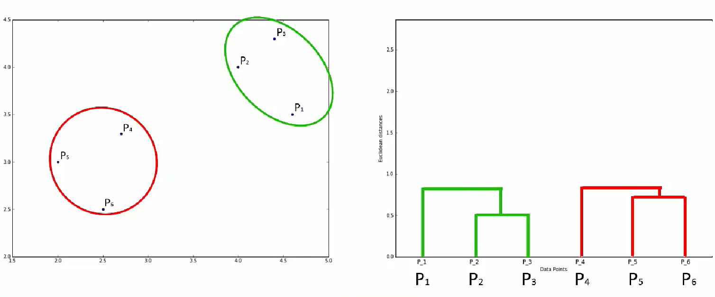
Hierarchial Clustering

Slide 14
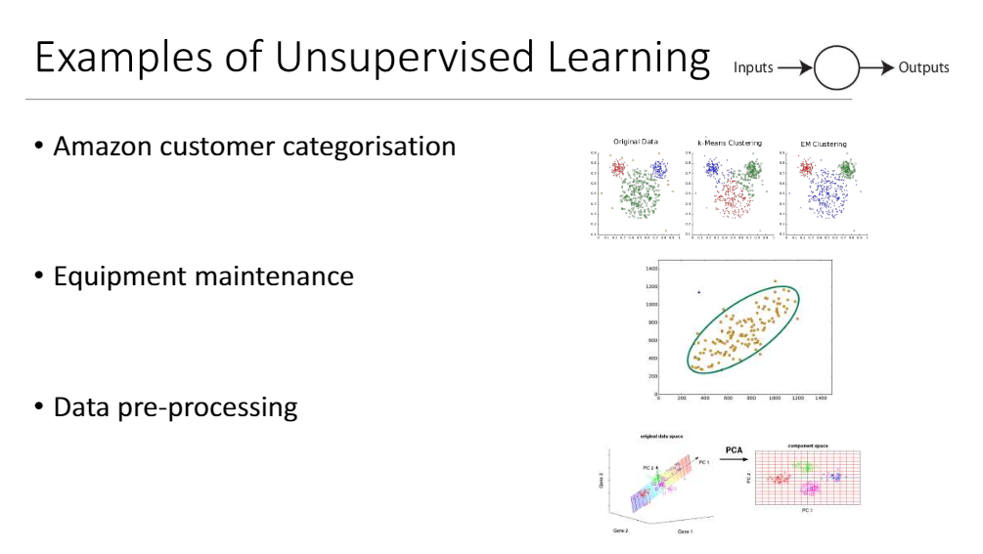

Slide 15
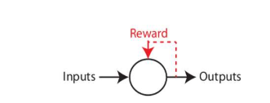
Reinforcement Learning
An RL agent learns by interacting with its environment and observing the results of these interactions
Mimics Human Learning.
Rewards and Punishments.
Gaming | Robotics
Facebook Ads

Slide 16
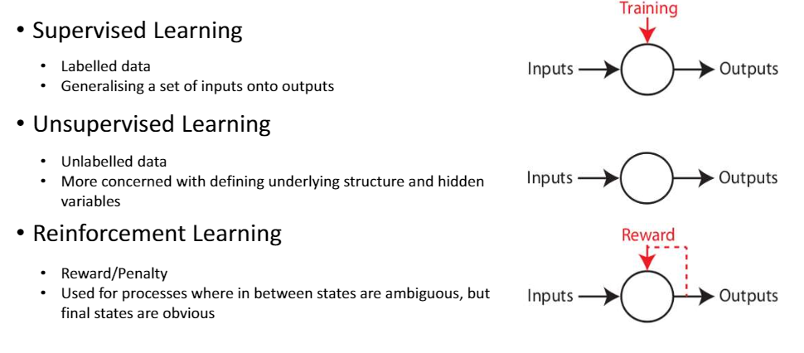

Slide 17
Neural Networks
Used for Regression, classification and Clustering problems
Applications:
  Image recognition
  Driver less cars
  Stock market prediction

Slide 18
Leveraging Python

Slide 19
How do I learn ML or Python in a single night?
I would suggest you to move to countries like Norway, Sweden, Finland and places like Alaska and North Canada which experience 6 months of daytime during summer (and 6 months of darkness during winters)

Slide 20
People thought machines are part of their lives,
But who knows …One day we might be part of the machines life.

